Slide 1
Welcome!
Please, have a seat.
CWRU Quants
quants@case.edu
Notes:
Christo

Slide 2
Agenda
Interview Structure
Resources
Notes:
Christo

Slide 3
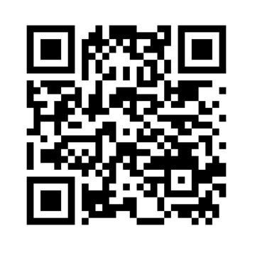
Attendance | CampusGroups
Notes:
Christo

Slide 4
Recruiting Process
Online Assessments
Mental Math
Logic
Interviews
Technical vs Soft
Final Round
dd
d
d
d
Notes:
Christo

Slide 5


Slide 6
Online Assessments (OA)
An online assessment is a virtual ‘test’ a company sends to you. It is intended to assess your ability in some skill (e.g. mental math, coding proficiency, brainteasers) and is meant to filter out applicants
Usually is unsupervised…but results are scrutinized to ensure honesty
Who to cut is decided on the performance of everyone else who applied
Quant is much less networking-based compared to traditional finance…
You will be evaluated based on what skills you have, not who you know
OAs are a way to ‘weed-out’ a large number of applicants (rather than in traditional finance, where those typically with referrals progress forward)
Some OAs are automatic, others require you to pass a resume screening process
Notes:
Christo

Slide 7
Mental Math Assessment
One OA you are likely to see is the mental math assessment
Here, you’ll be asked a series of MM questions (typically integer-based addition/subtraction/multiplication/division)
You’ll be assessed based on the correctness of your responses and how much you are able to answer (did you answer all the questions? How many did you get wrong?)
You may also encounter some pattern recognition problems (i.e. what shape comes next in this series?)
https://arithmetic.zetamac.com/
Notes:
Christo

Slide 8
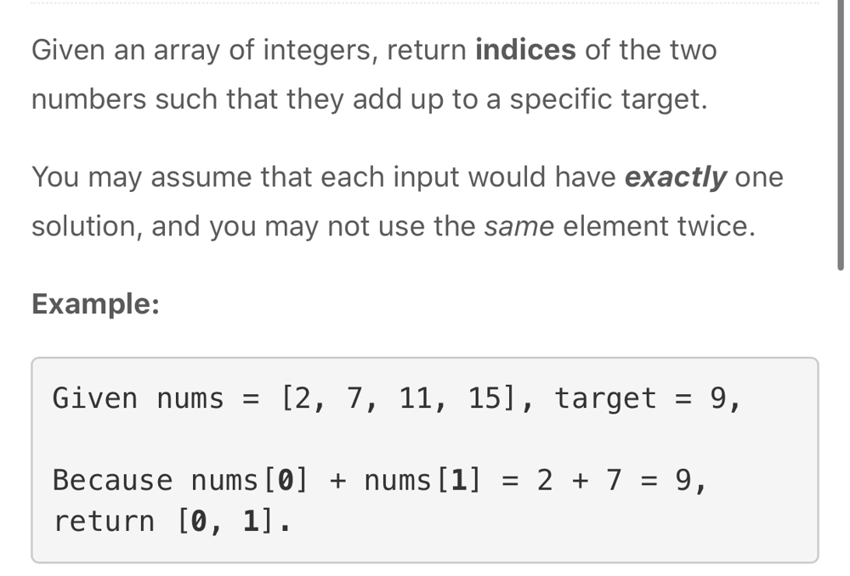
Coding Proficiency (Leetcode)
Another style of OA you’ll likely see is leetcode-style
Here, you’ll be asked a variety of simple(?) questions regarding data structures and algorithms
Your answer will be measured against a series of test cases (how well does it perform relative to time/space complexity?)
Even if you are not pursuing a strictly computer science role (e.g. developer), you still should have some level of programming knowledge
Traders should know python
CS will be much more low-latency focused
Notes:
Christo

Slide 9
Coding Proficiency (Phone)
If you do well on that coding OA, a phone interview with a developer at the firm will most likely be the next step in the hiring process
Phone interviews tend to be trivia-heavy
Subjects like computer architecture, operating systems, networks, and some math/algorithms will be tested
Notes:
Christo

Slide 10
Coding Proficiency (Interview)
Coding interviews vary widely depending on the firm
Some are implementation heavy (eg. build Tetris in an hour)
Some are algorithm heavy (graph traversal, dynamic programming, etc)
Some test knowledge of how a computer works (stack grow upward or downward)
Some test knowledge of how a compiler works (usually C++)
Notes:
Christo

Slide 11

Logic / Reaction Speed Assessments
Another style of online assessment is going to be the logic and reaction speed games
Typically, you will have to complete these assessments with with the shortest amount of “moves,” demonstrating IQ and intuition
Reaction speed
Notes:
Christo

Slide 12
Hirevue(s)
Hirevue - A online ‘interview’ where you are asked a series of questions and your answers are recorded
A human will then review your answers
This is meant to access how well-prepared you are and ‘know your story’
Questions will typically be more behavioral in nature, though you may be asked a few brainteasers
Make sure to maintain eye contact with the camera
Some OAs are also recorded…
Notes:
Christo

Slide 13
Interviewing
Notes:
Christo

Slide 14
Phone Screen
Once you progress past the OAs you may be have a more technical (non-HR) phone screen with someone on the team (a trader, dev, etc.)
Trader - questions about options theory
Dev - System design, programming fundamentals
Research - Project experience
This is also your chance to ask questions and get to know the company better
Notes:
Christo

Slide 15
Group Interview
Sometimes you may be placed in a group interview…where you’ll be assessed live against other potential candidates
You’ll probably play a game and see who does the best in the group
You may also be asked other typical interview questions
You may also be asked to collaborate with others
It’s important to maintain your composure
Notes:
Christo

Slide 16
Final Round
Once you get to the final round, it’s more about behavior and ‘fit’ rather than technical prowess
It’s important to know your ‘why’ (both about the firm and yourself, and be able to communicate your story)
You will also likely be flown out to the company, so ensure that you have the proper attire and display fine etiquette
If you are given a tour of the office, make sure to be friendly with all the staff and be on your best behavior!
Notes:
Christo

Slide 17
Resources
https://github.com/northwesternfintech/2025QuantInternships
Very very good resource, has a relatively exhaustive list of internships with information about selectivity and when they open/close
Notes:
Christo

Slide 18
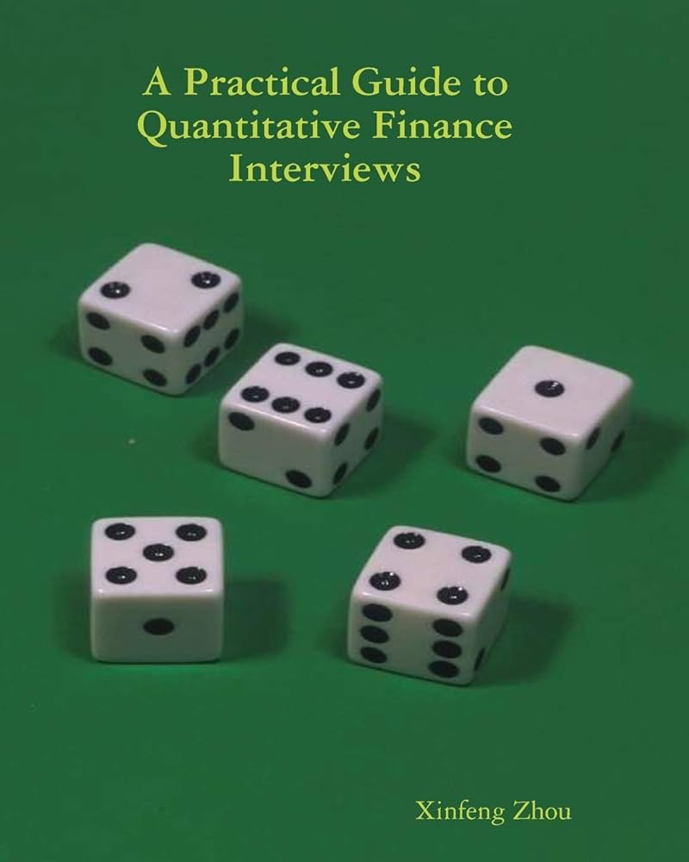
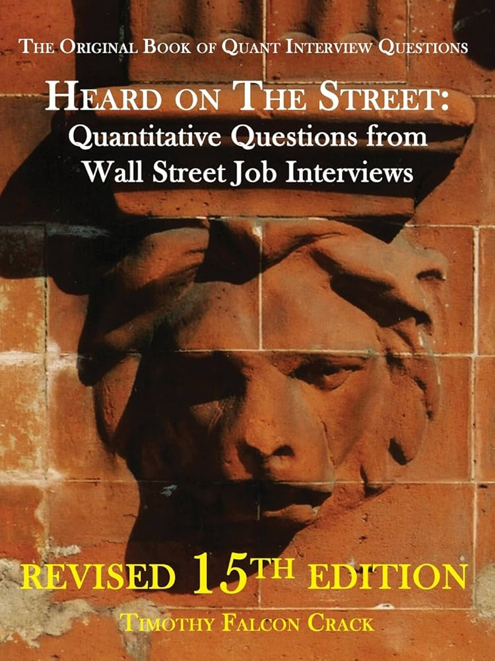
Resources
Online Assessments
Leetcode (coding algorithms)
ZetaMac (mental math)
Brain Teasers and Probability
Green book ->
Heard on the Street
Youtube Series on Quant Interviews
History:
Flash boys - Michael Lewis
The Quants - Scott Patterson
Notes:
Christo

Slide 19
QUESTIONS AND ANSWERS
Contact us!
Email: quants@case.edu
Instagram: @cwruquants

